Slide 1

WESAD Dataset: Werable Stress Affect Detection
Andrei Vlasov
Nikolay Shvetsov
Van Khachatryan

Slide 2


The problem
Stress detection
Classification of person emotional condition
Understanding of stress features
Search optimal ML model

Slide 3
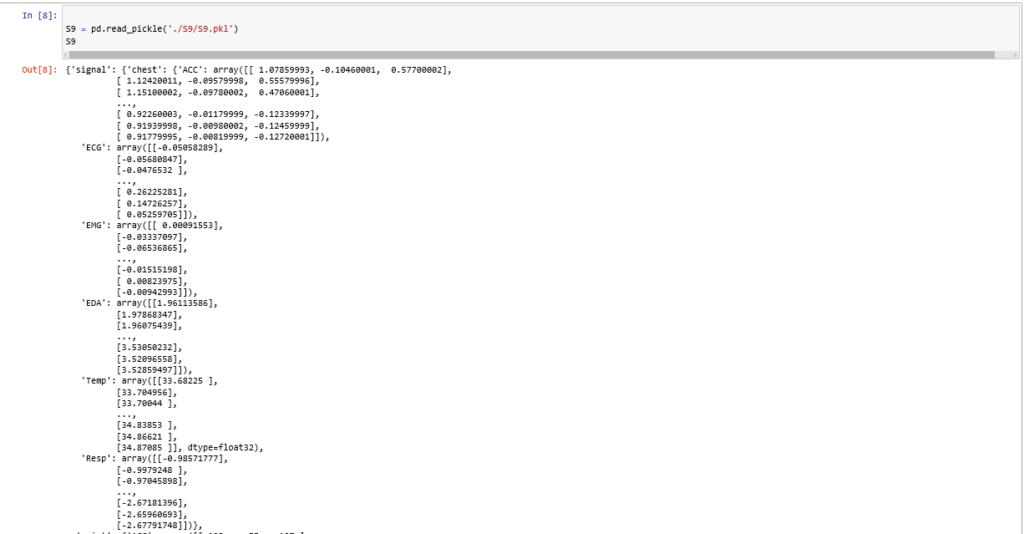
Raw data from Pickle file

Slide 4
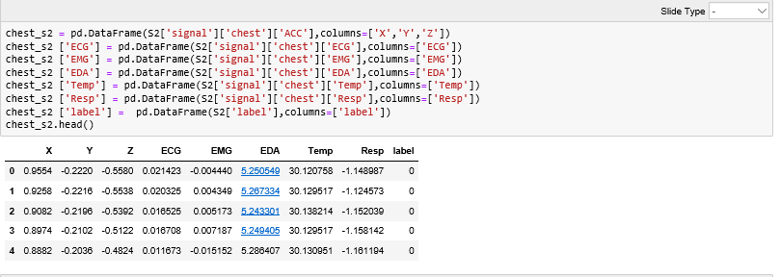
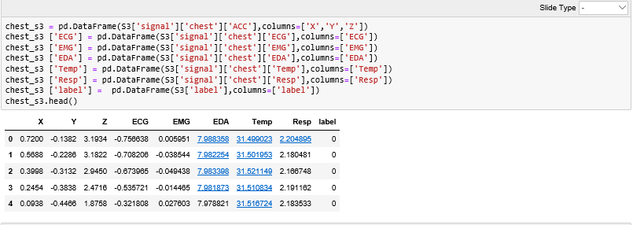
Chest DataFrame, Idea to make DataFrames for each person ,extract features and after merge them, in the end we will make classification models for united DataFrane

Slide 5
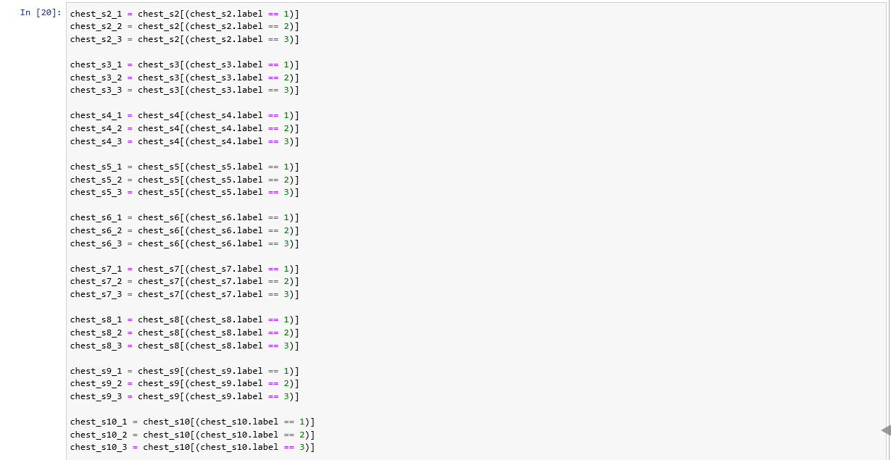
Lets extract labels, which will be our targets. Where 1 is baseline, 2 is stress,3-amusement

Slide 6
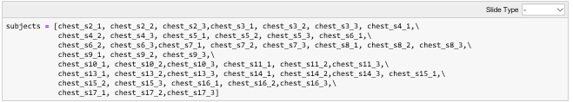
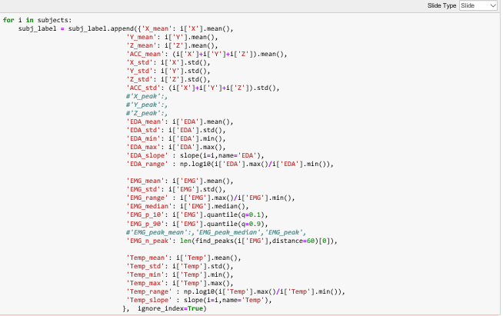
All subjects were completed in one DataFrame, and Feature were extracted

Slide 7
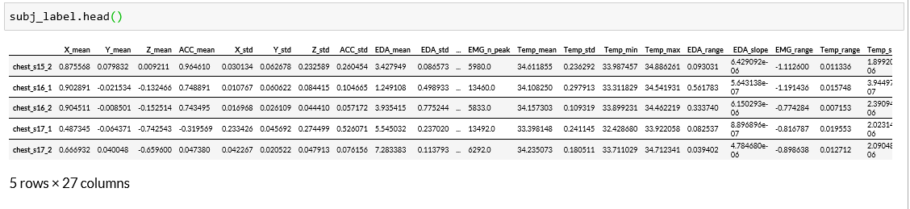
The final DataFrame with features

Slide 8
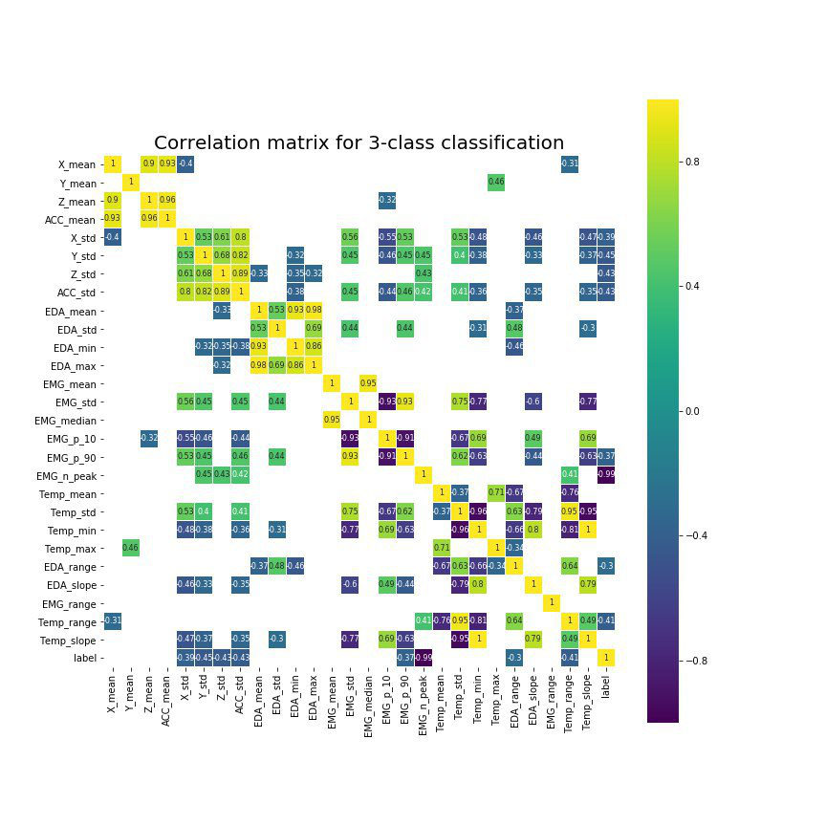
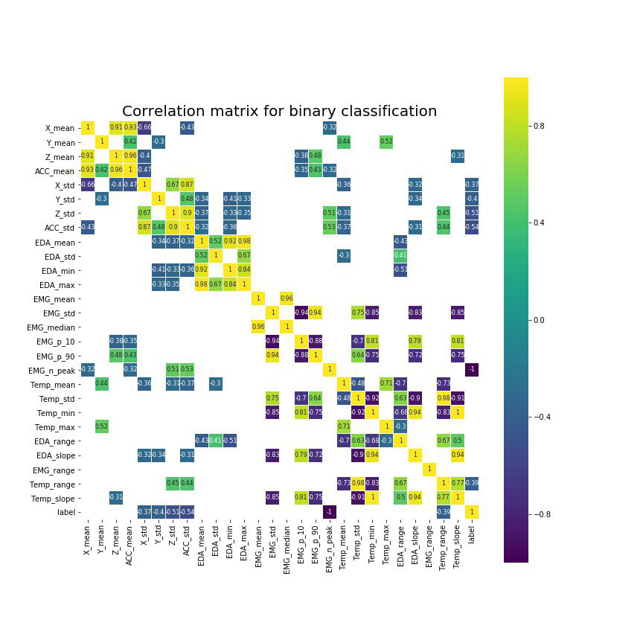
We split our data to X and Y, where Y is Labels and made correlation heatmap

Slide 9
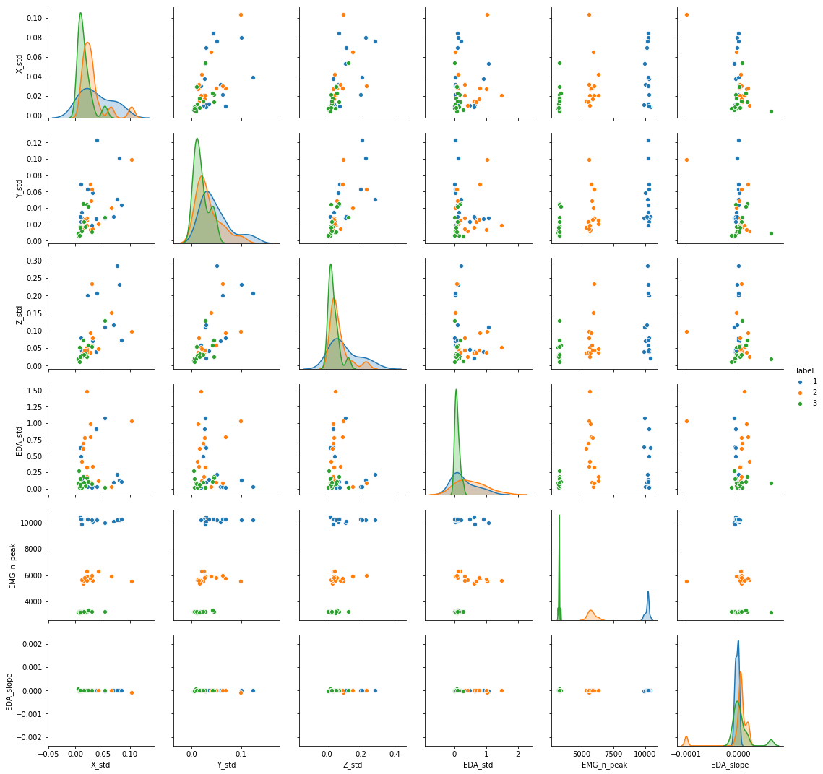

Pairwise relationships between features for 3-class classification
Vars:
X_std
Y_std
Z_std
EDA_std
EMG_n_peak
EDA_slope
Hue=label

Slide 10
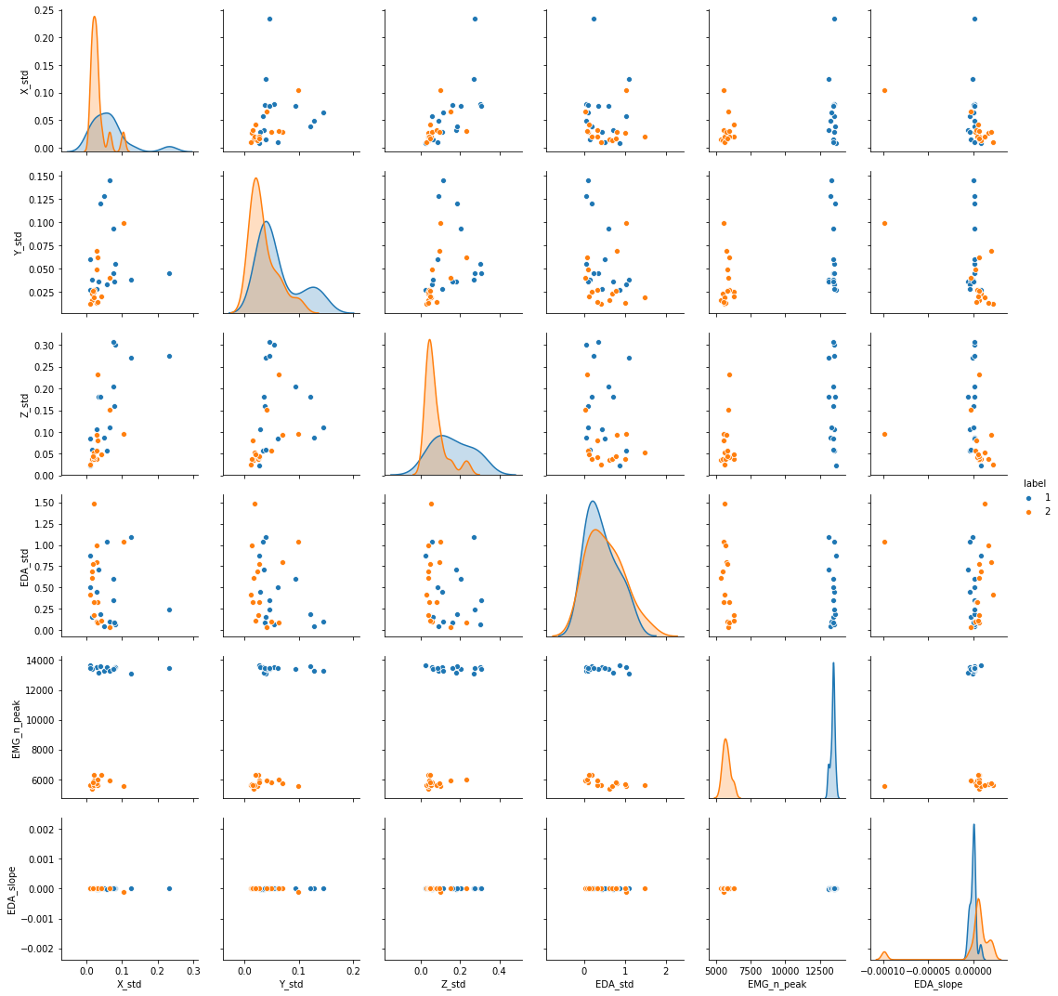

Pairwise relationships between features for binary classification
Vars:
X_std
Y_std
Z_std
EDA_std
EMG_n_peak
EDA_slope
Hue=label

Slide 11
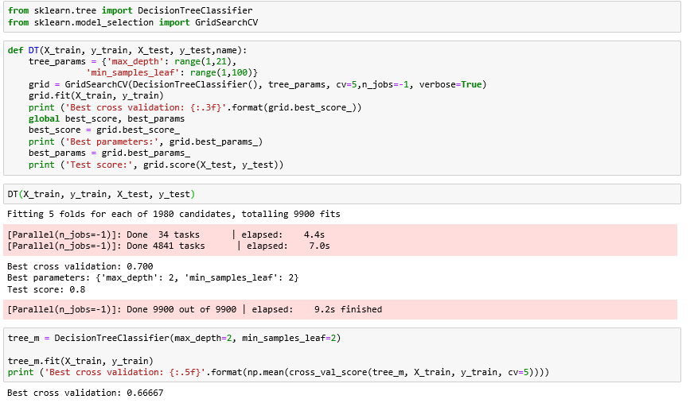
First model for three class modalities: Decision tree Best cross validation: 0.7 , Test score: 0.8

Slide 12
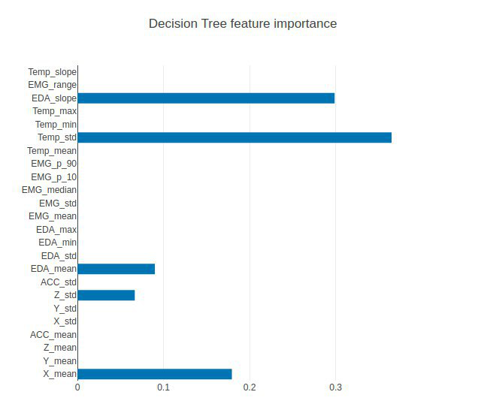
Decision Tree Feature Importance

Slide 13
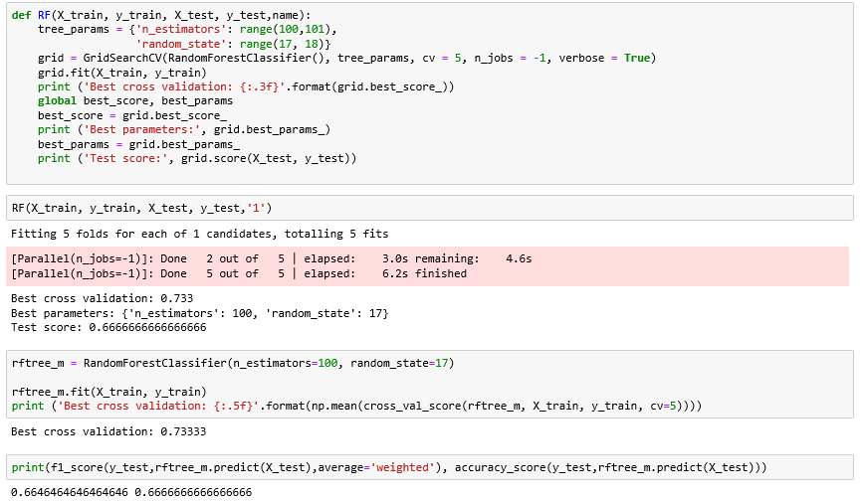
Random Forest Best cross validation: 0.733, Test score: 0.66

Slide 14
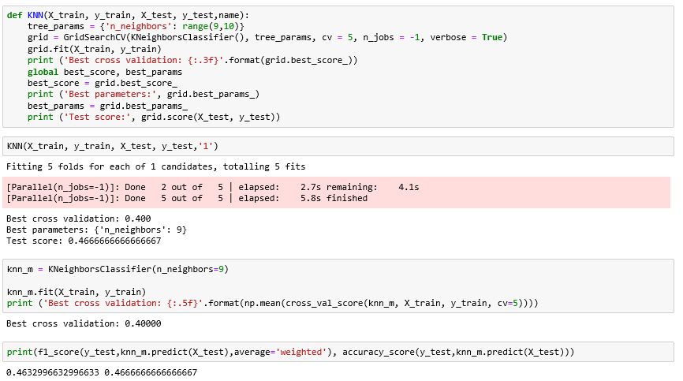
KNN Best score validation: 0.4, neighbors=9, Test score: 0.46

Slide 15
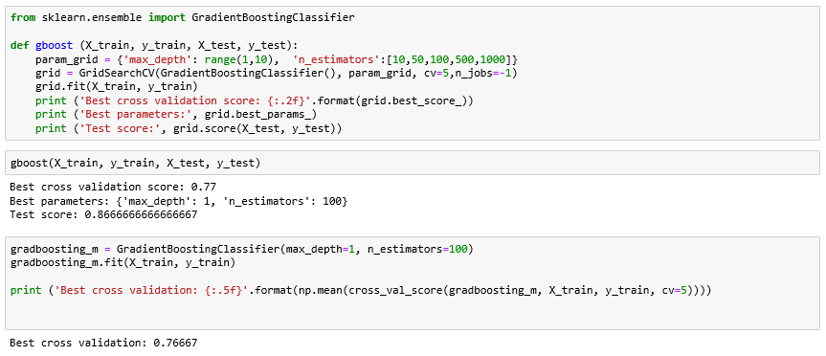
Gradient Boosting Best score validation: 0.77, Test score: 0.86

Slide 16
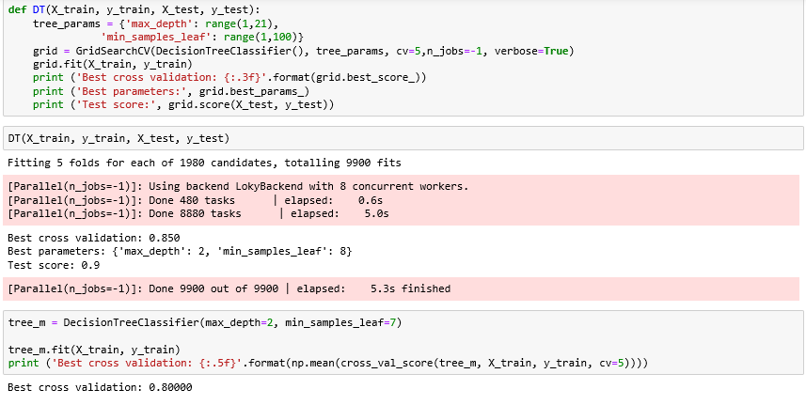
Model binary classification: Decision tree Best cross validation: 0.85 , Test score: 0.9

Slide 17
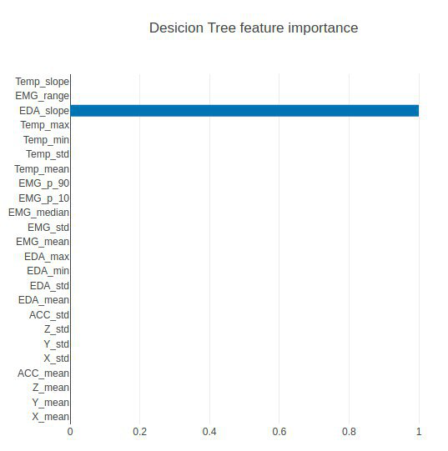
Decision Tree Feature Importance

Slide 18
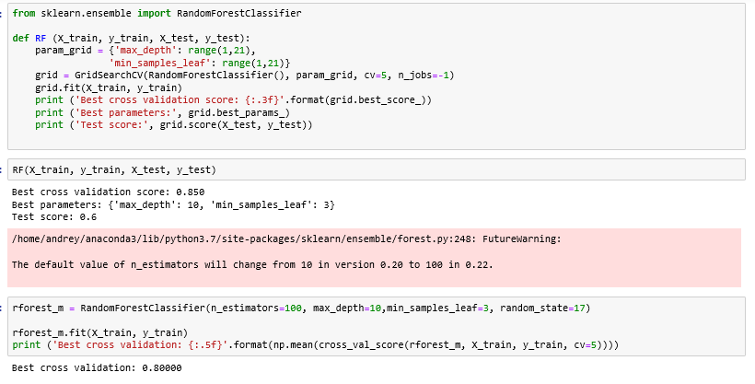
Random Forest. Best cross validation: 0.85, Test score: 0.6

Slide 19
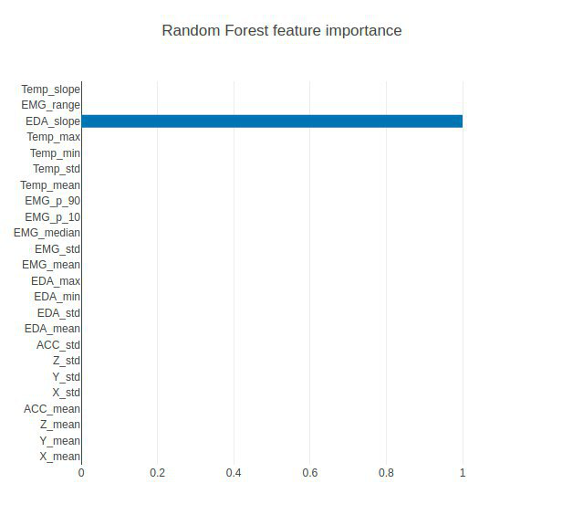
Random Forest Feature Importance

Slide 20
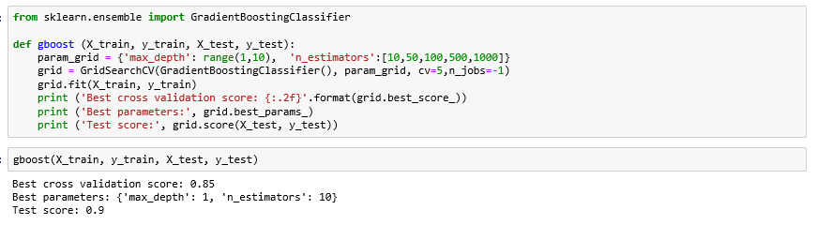
Gradient boosting Best cross validation: 0.85, Test score: 0.9

Slide 21
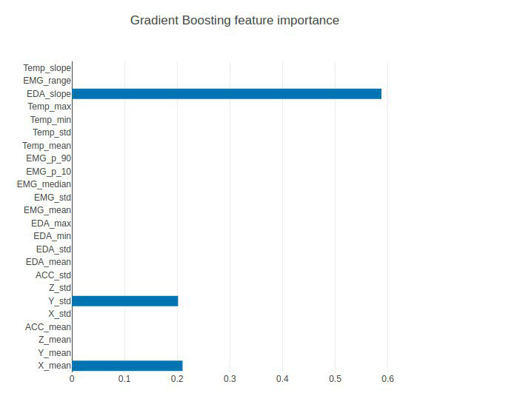
Gradient boosting Feature Importance

Slide 22
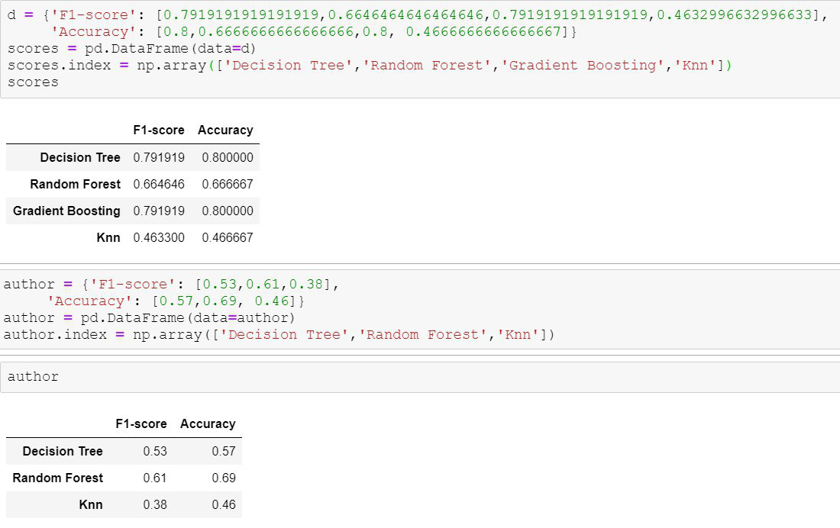
Results: three class modalities

Slide 23
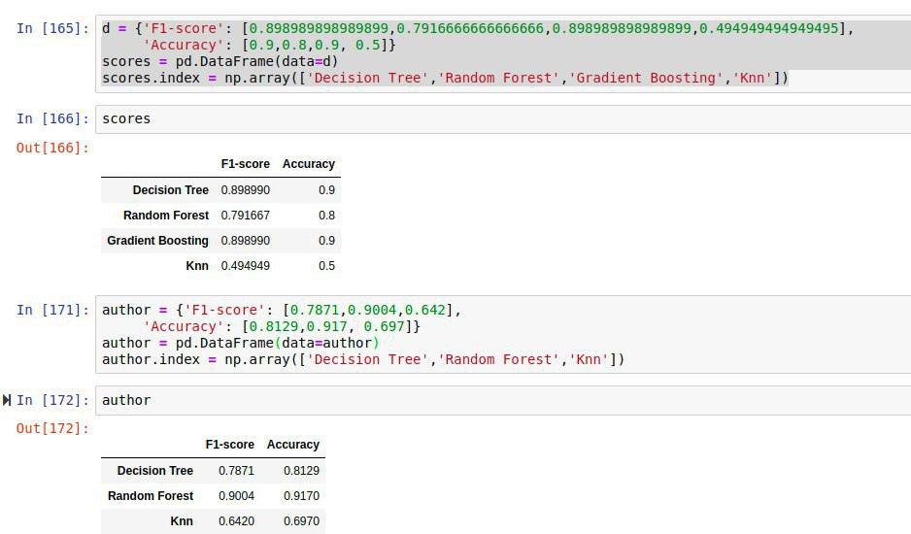
Results: Binary

Slide 24
Three class models
Conclusion
Binary models
We can repeat results for such models: Random Forest and KNN, accuracy and F1 almost equal between our work and authors(0.66 and 0.69 hence for Forest and 0.46-0.46 for KNN).
Also we can see that our model of Decision Tree equal to 0.8, but authors 0.57. We can explain it by another feature extraction.
For binary models we almost repeat results of authors. We can explain it by another feature extraction.

Slide 25
Thank you for your attention!

